Slide 1

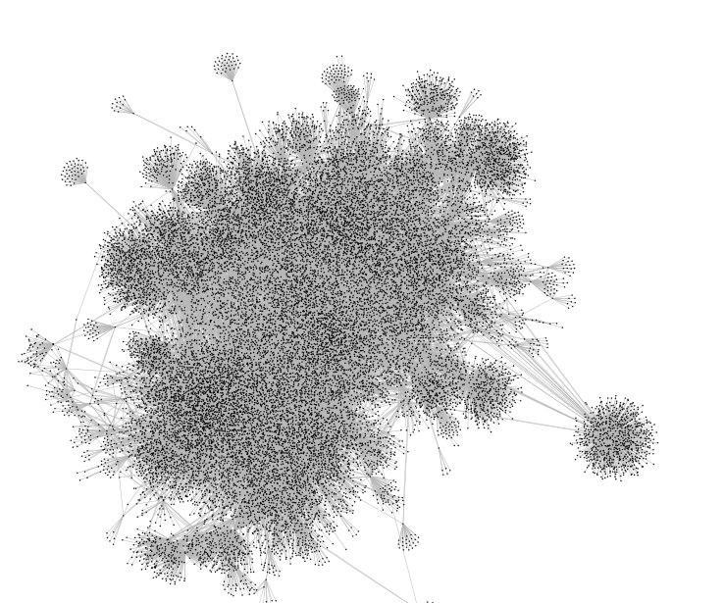
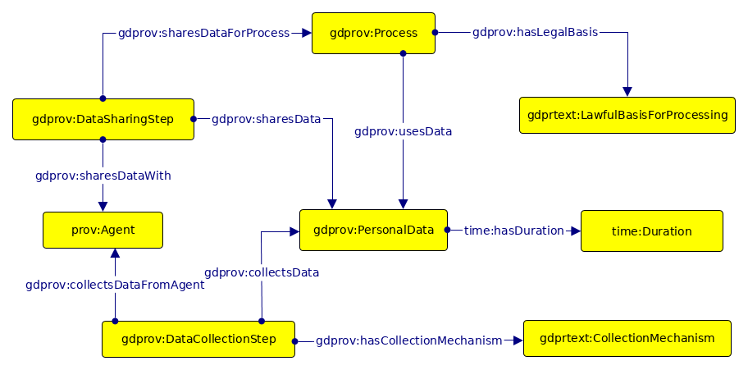

Using Ontology Design Patterns To Define SHACL Shapes
Harshvardhan J. Pandit, Declan O'Sullivan, Dave Lewis
ADAPT Centre, Trinity College Dublin, Dublin, Ireland { harshvardhan.pandit | declan.osullivan | dave.lewis } @ adaptcentre.ie
@coolharsh55 https://openscience.adaptcentre.ie/
Ontology A
Given Data Graph uses several Ontologies
Consider cases where only some (or few) concepts and relationships are used
A Data Graph may therefore selectively use parts of the ontology
Here, axioms from the defined ontologies may not be applicable over data graph for validation
Ontology B
Ontology C
Data Graph
axiom
ODP is re-used or created for data graph
Axioms are defined for consistency
Axioms can use terms and properties from any of the used ontologies
Axioms are specific to the data graph
Axioms therefore represent the data model
axiom
axiom
axiom
axiom
ODP
axiom
ex:Shape
a sh:NodeShape ;
sh:targetClass ex:Person ;
sh:property [
sh:path ex:ssn ;
sh:maxCount 1 ;
sh:datatype xsd:string ;
sh:pattern "^\\d{3}-\\d{2}-\\d{4}$" ;
] ;
sh:property [
sh:path ex:worksFor ;
sh:class ex:Company ;
sh:nodeKind sh:IRI ;
] ;
sh:closed true ;
Generate SHACL shapes from Axioms in ODP
Validate Data Graph using axioms
Align Data Model (axioms) with Validation (SHACL)
Benefits of using ODP in this context:
Visualise SHACL shapes
Summarise Data (as patterns)
Provide a “schema” for data graph that can be reused
Future Work
Mappings between OWL2 Axioms and SHACL Shapes
Incorporate SHACL-SPARQL
Automate generation of SHACL shapes for given data graph
ex:Shape
a sh:NodeShape ;
sh:targetClass ex:Person ;
sh:property [
sh:path ex:ssn ;
sh:maxCount 1 ;
sh:datatype xsd:string ;
sh:pattern "^\\d{3}-\\d{2}-\\d{4}$" ;
] ;
sh:property [
sh:path ex:worksFor ;
sh:class ex:Company ;
sh:nodeKind sh:IRI ;
] ;
sh:closed true ;
ex:Shape
a sh:NodeShape ;
sh:targetClass ex:Person ;
sh:property [
sh:path ex:ssn ;
sh:maxCount 1 ;
sh:datatype xsd:string ;
sh:pattern "^\\d{3}-\\d{2}-\\d{4}$" ;
] ;
sh:property [
sh:path ex:worksFor ;
sh:class ex:Company ;
sh:nodeKind sh:IRI ;
] ;
sh:closed true ;
ex:Shape
a sh:NodeShape ;
sh:targetClass ex:Person ;
sh:property [
sh:path ex:ssn ;
sh:maxCount 1 ;
sh:datatype xsd:string ;
sh:pattern "^\\d{3}-\\d{2}-\\d{4}$" ;
] ;
sh:property [
sh:path ex:worksFor ;
sh:class ex:Company ;
sh:nodeKind sh:IRI ;
] ;
sh:closed true ;
SHACL Shapes
Presented at 9th Workshop on Ontology Design Patterns (WOP2018)
Co-located with 17th International Semantic Web Conference (ISWC2018)
The ADAPT Centre for Digital Content Technology is funded under the SFI Research Centres Programme
(Grant 13/RC/2106) and is co-funded under the European Regional Development Fund.
Notes:
Notes
Do not change font size – check with us if you really cannot make the space work for you

